Slide 2
WHITNEY HOUSTON
a pop music icon

Slide 3
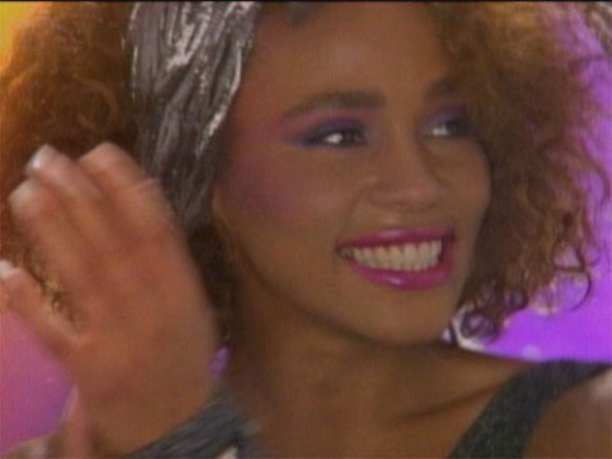
Whitney Houston was the first African-American artist to get major airplay on MTV, More than even Michael Jackson, with this 1985 pop hit.
https://youtu.be/m3-hY-hlhBg

Slide 4
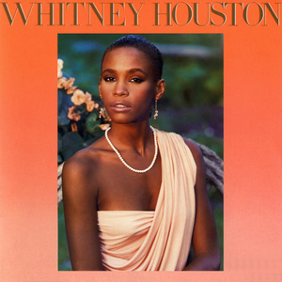
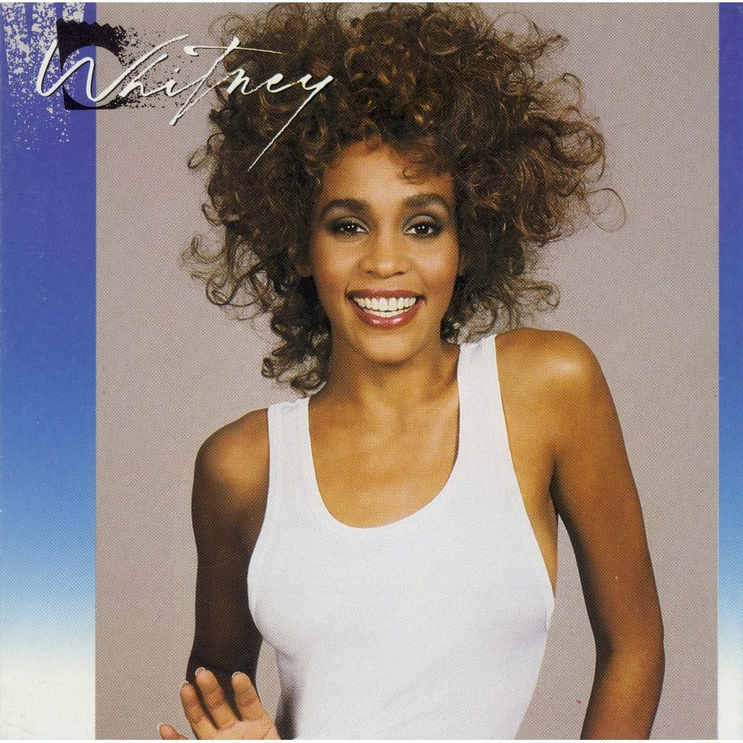
Whitney Houston Holds the Record of charting how many consecutive #1 Billboard hits?

Slide 5
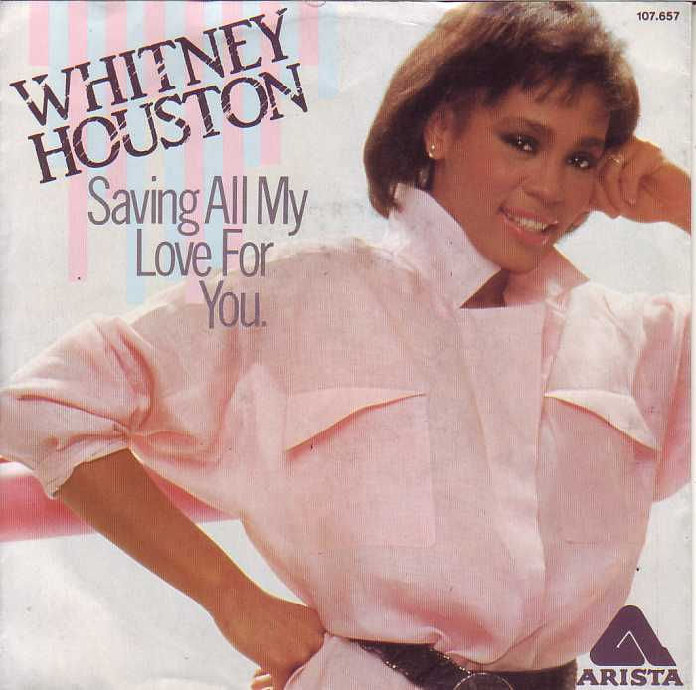

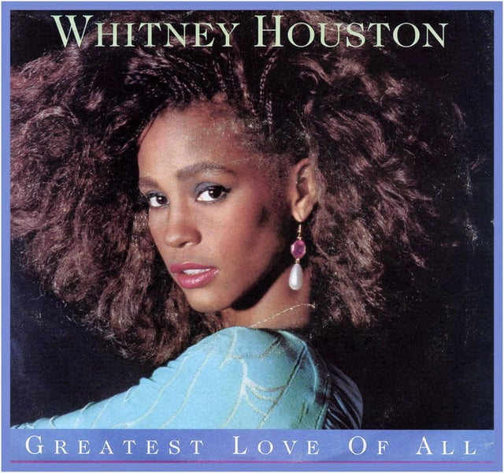
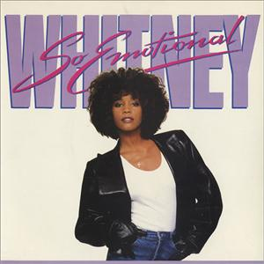

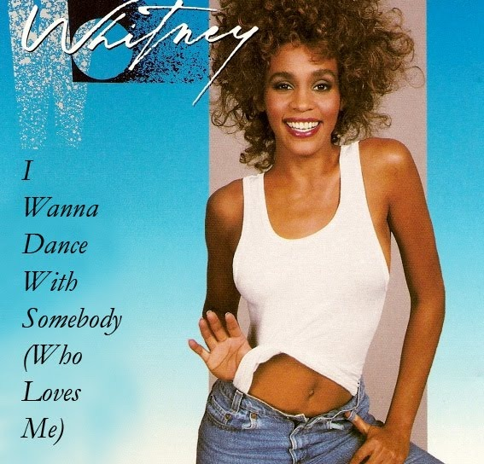

SEVEN

Slide 6
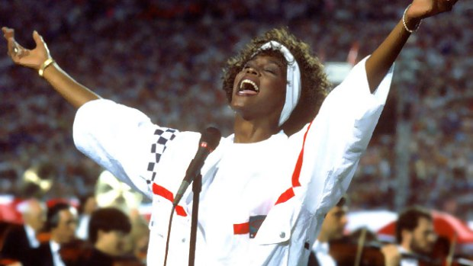
Whitney Houston is the only artist in history to make a pop hit out of what song when she sang it at Super Bowl 25?
https://youtu.be/N_lCmBvYMRs

Slide 7
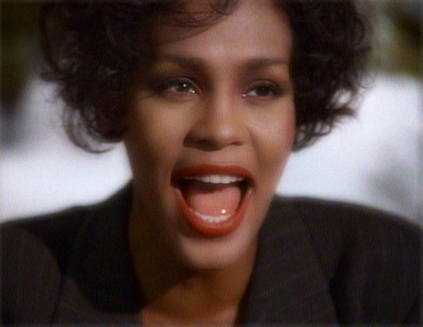
Whitney Houston holds the record for the best selling single by a female artist in music history with what song?
https://youtu.be/3JWTaaS7LdU

Slide 8
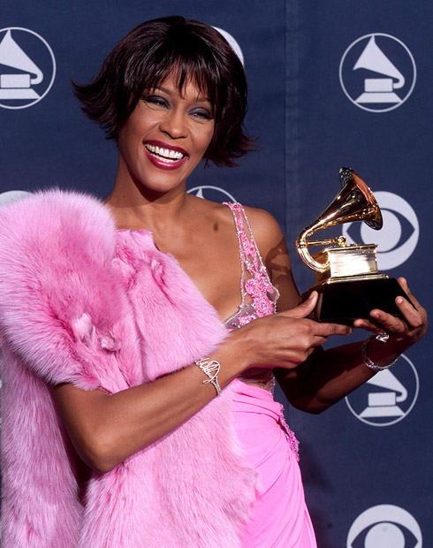
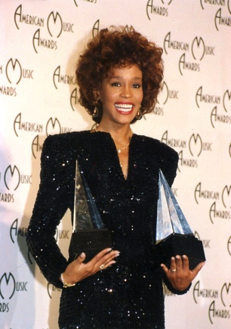
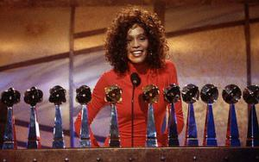
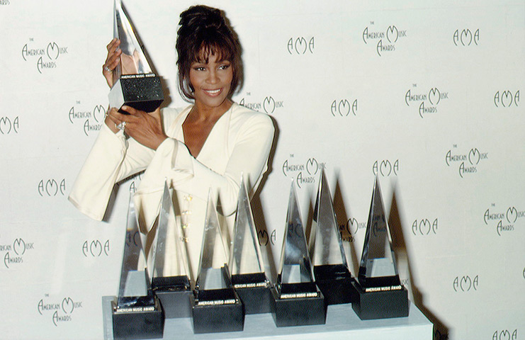
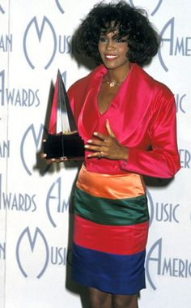
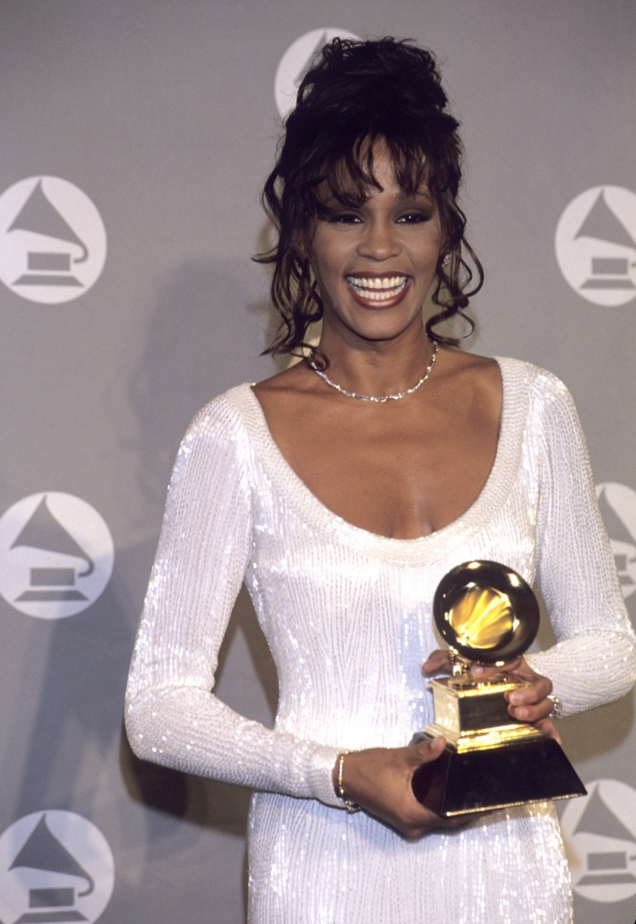
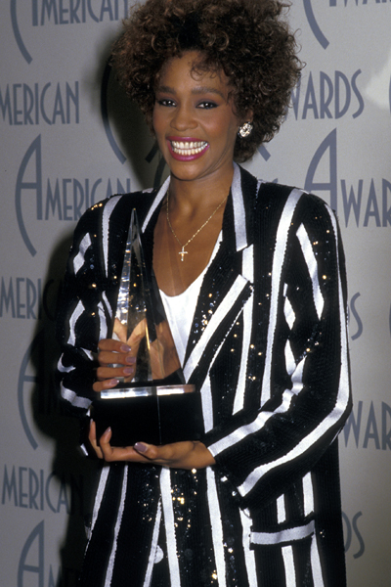
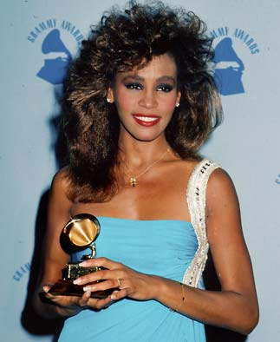
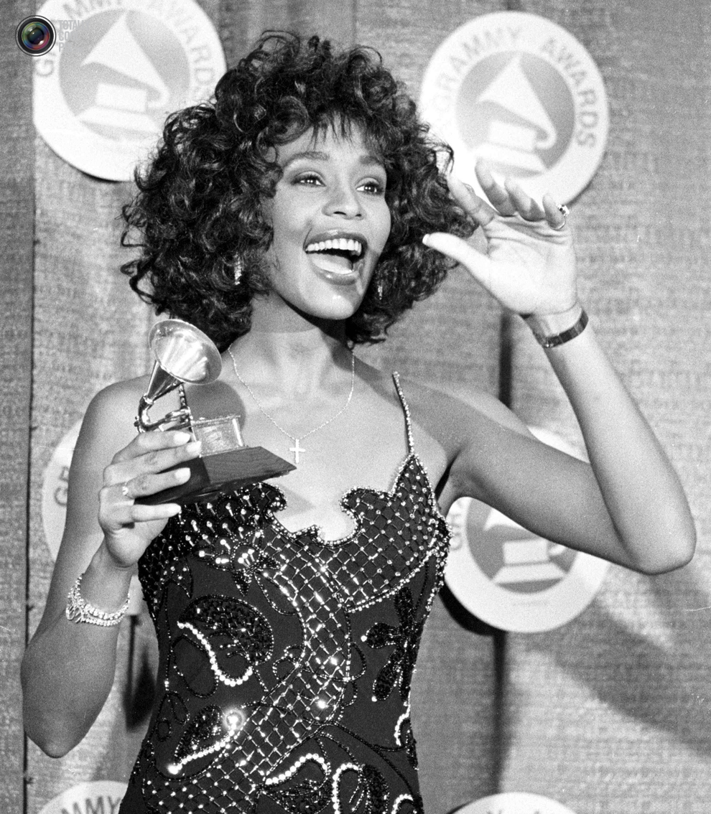
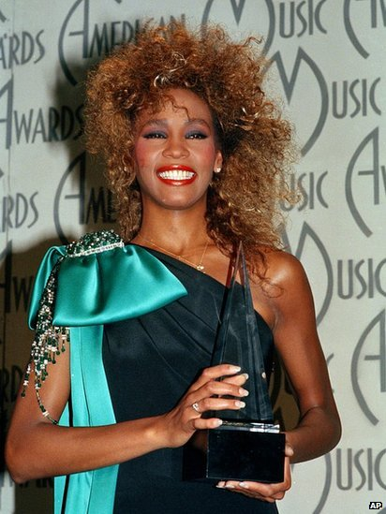
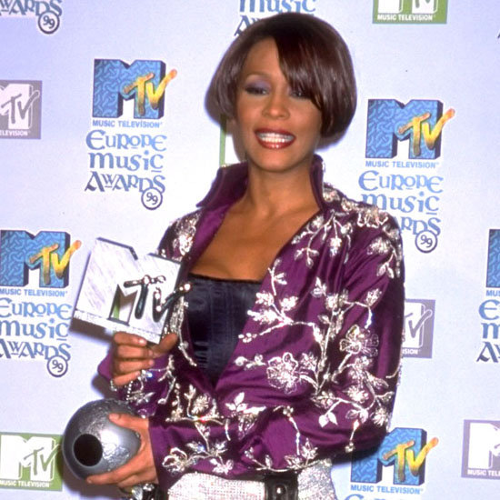
Whitney Houston is the most awarded female artist in history. How many?

Slide 9
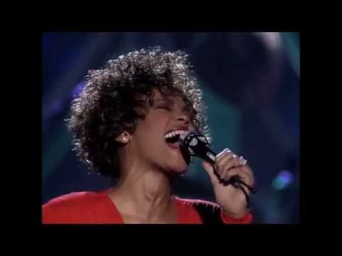
“Whitney Houston was blessed with an astonishing vocal range and extraordinary technical skill, but what truly made her a great singer was her ability to connect with a song and drive home its drama and emotion with incredible precision.”
https://youtu.be/xmIp8j2cjDQ

Slide 10
